Slide 1
Predicting Forest Cover Types
Classification Problem
Data:(US Geological Survey and USFS)

Slide 2
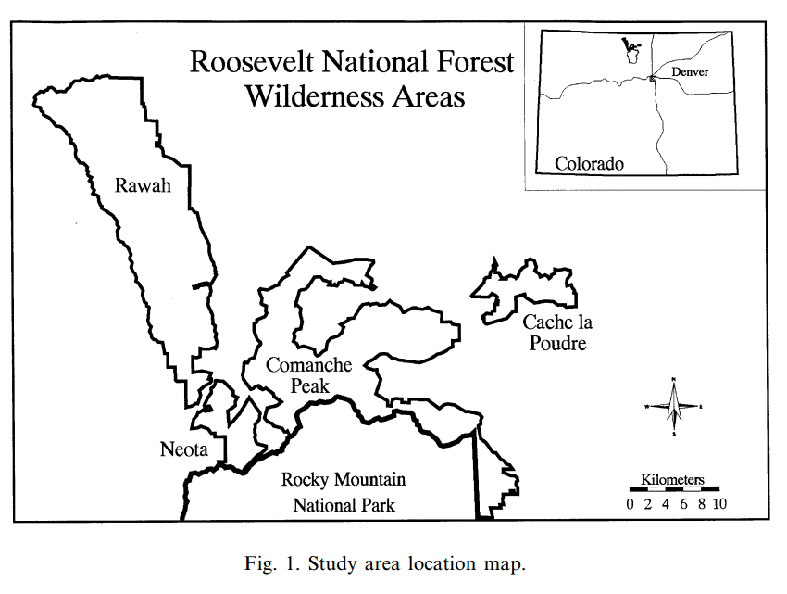
Description
In this competition you are asked to predict the forest cover type. The actual forest cover type for a given 30 x 30 meter cell was determined from US Forest Service (USFS) Region 2 Resource Information System data. Independent variables were then derived from data obtained from the US Geological Survey and USFS.
This study area includes four wilderness areas located in the Roosevelt National Forest of northern Colorado. These areas represent forests with minimal human-caused disturbances, so that existing forest cover types are more a result of ecological processes rather than forest management practices.

Slide 3
Description
Data Fields
Cover Types
1 - Spruce/Fir
1. Elevation (m),
2. Aspect (azimuth from true north),
3. Slope (°),
4. Horizontal distance to nearest surface water feature (m),
5. Vertical distance to nearest surface water feature (m),
6. Horizontal distance to nearest roadway (m),
7. A relative measure of incident sunlight at 09:00 h on the summer solstice (index),
8. A relative measure of incident sunlight at noon on the summer solstice (index),
9. A relative measure of incident sunlight at 15:00 h on the summer solstice (index),
10. Horizontal distance to nearest historic wildfire ignition point (m),
11. Wilderness area designation (four binary values, one for each wilderness area), and
12. Soil type designation (40 binary values, one for each soil type).
2 - Lodgepole Pine
3 - Ponderosa Pine
4 - Cottonwood/Willow
5 - Aspen
6 - Douglas-fir
7 - Krummholz

Slide 4
Description
We are provided with train data and test data. Train data is much smaller than test data.
Test Data
565,892 rows
-55 columns
56 vs 55 columns
Train Data
- 15,120 rows
- 56 columns
Test Data is missing Cover Types. You need to upload your prediction data to Kaggle to get the actual result.

Slide 5
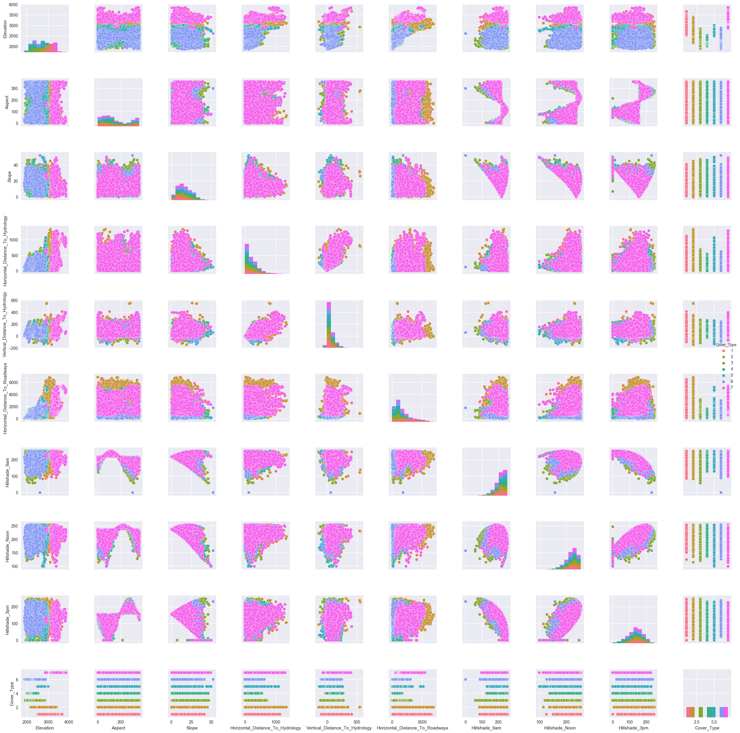
Exploratory Data Analysis (numerical columns)

Slide 6
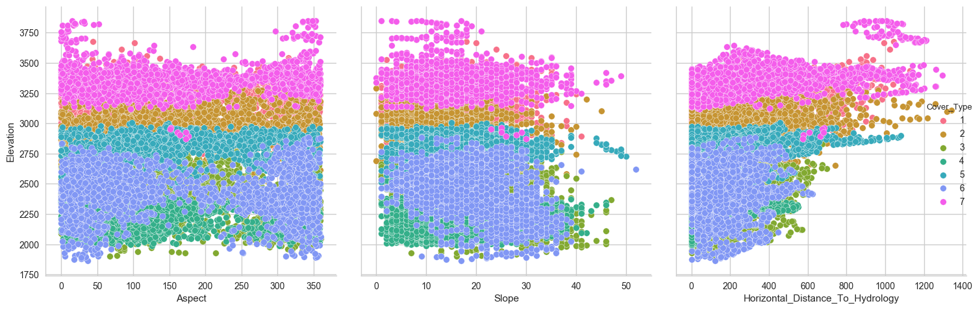
Exploratory Data Analysis (numerical columns)
Elevation looks like an important classifier.

Slide 7
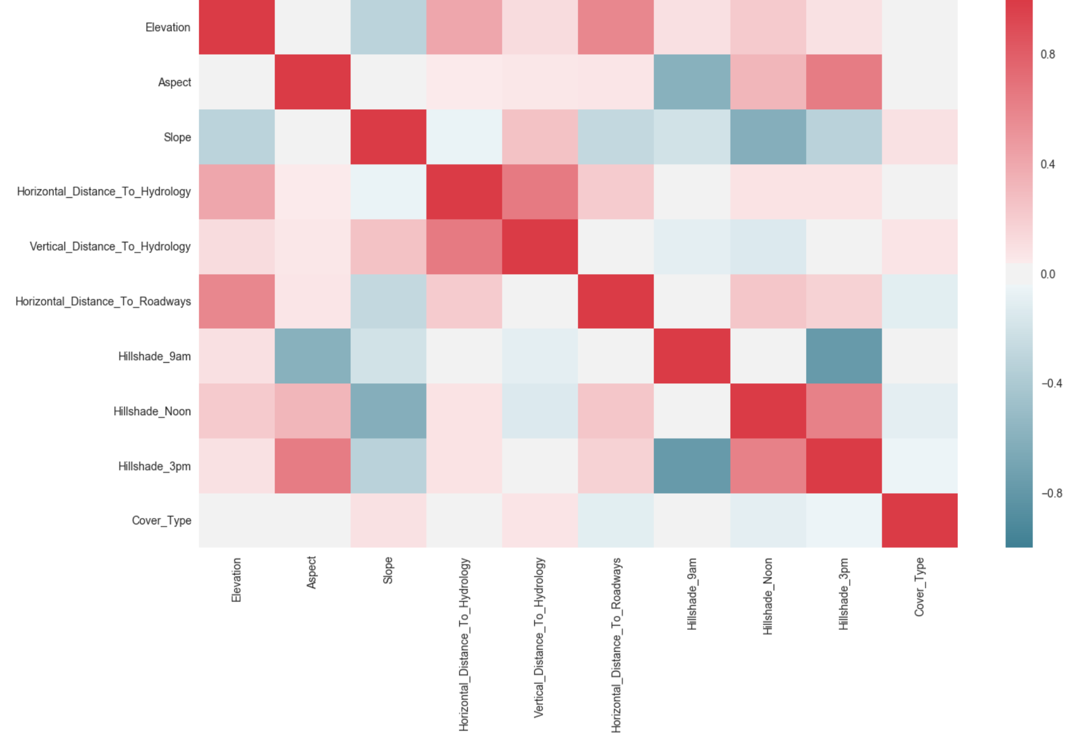
Exploratory Data Analysis (numerical columns)

Slide 8
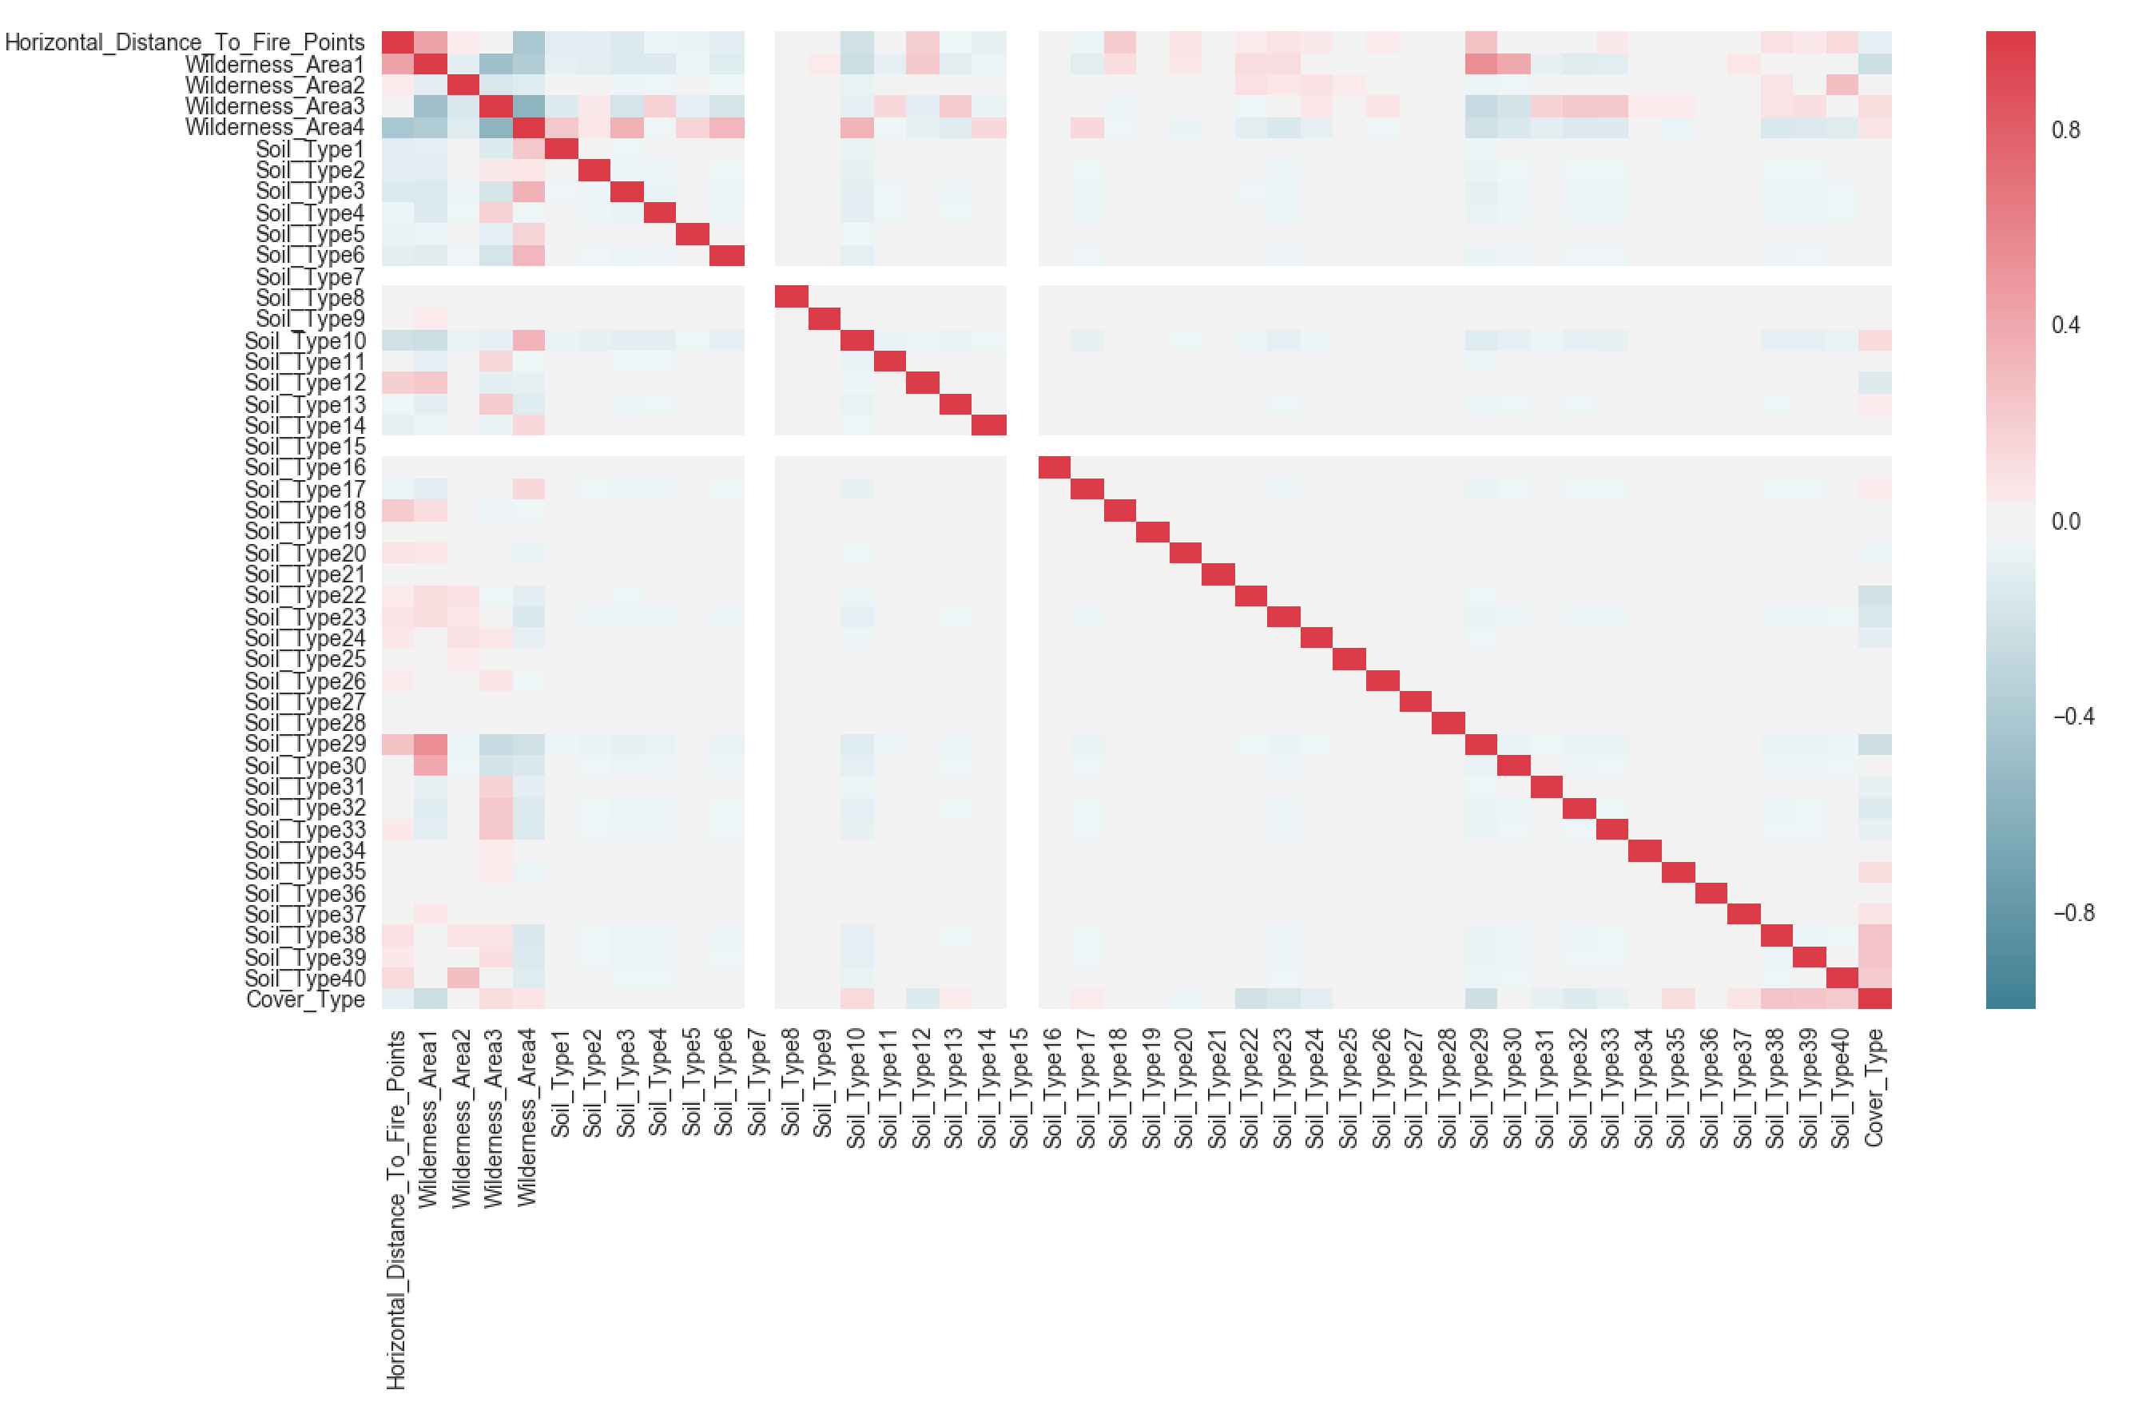
Exploratory Data Analysis (binary columns)

Slide 9
Models
We will use the following classifying techniques in order to find the model that best classifies/predict data:
k-NN –Approach
Decision Tree
Random Forrest

Slide 10
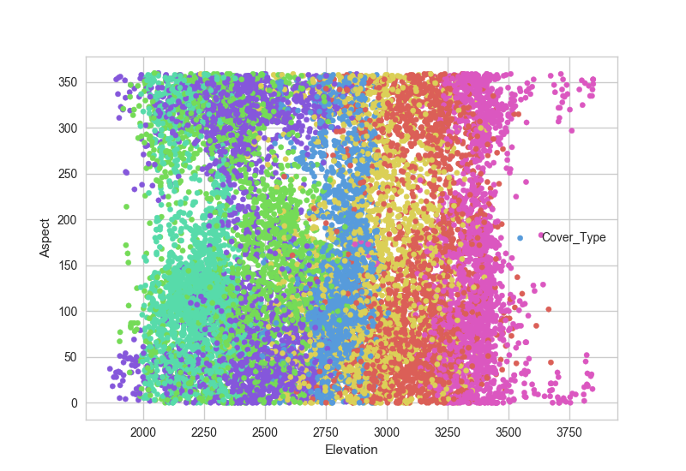
k-NN Approach full training set
- n_neighbours = 5 - weight = distance
Predicted

Slide 11
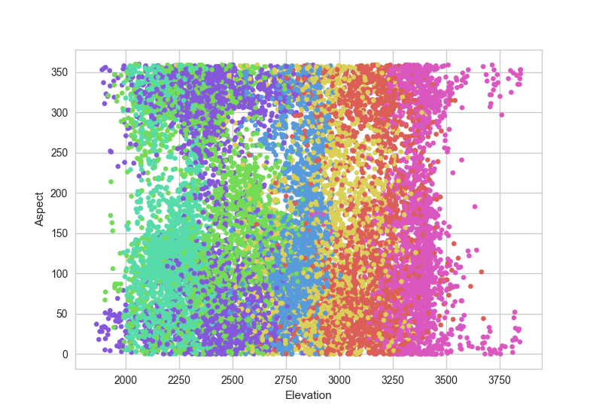
k-NN Approach full training set
- n_neighbours = 5 - weight = distance
Actual

Slide 12
classifiers precision recall f1-score support
1 0.98 1.00 0.99 2160
2 0.98 0.99 0.99 2160
3 0.98 1.00 0.99 2160
4 1.00 0.99 0.99 2160
5 1.00 0.98 0.99 2160
6 1.00 0.98 0.99 2160
7 1.00 0.99 1.00 2160
avg / total 0.99 0.99 0.99 15120
k-NN Approach full training set
- n_neighbours = 5 - weight = distance
Predicted
Actual

Slide 13
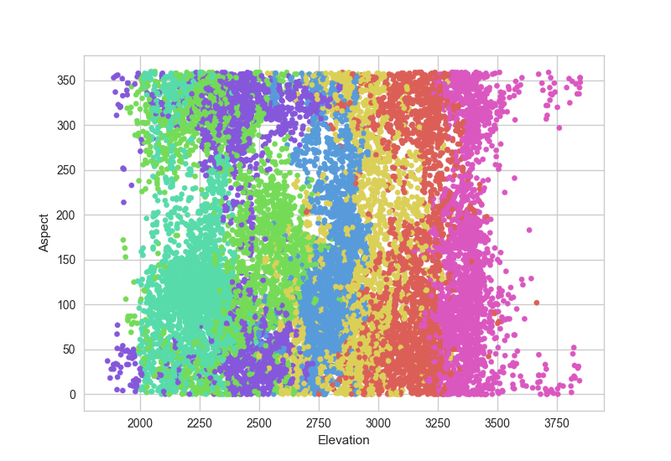
k-NN Approach full training set
- n_neighbours = 5 - weight = uniform
Predicted

Slide 14
k-NN Approach full training set
- n_neighbours = 5 - weight = uniform
Actual

Slide 15
Classifiers precision recall f1-score support
1 0.67 0.68 0.68 2160
2 0.61 0.55 0.58 2160
3 0.62 0.64 0.63 2160
4 0.75 0.85 0.80 2160
5 0.73 0.78 0.76 2160
6 0.71 0.59 0.65 2160
7 0.86 0.88 0.87 2160
avg / total 0.71 0.71 0.71 15120
k-NN Approach full training set
- n_neighbours = 5 - weight = distance
Predicted
Actual

Slide 16
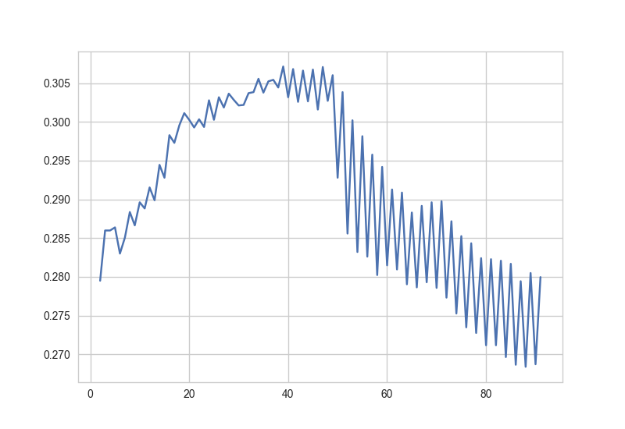
k-NN Approach full training set (GridSearch)
Fitting on all columns
-k = list(range(2, 100)) params={'n_neighbors':k,'weights':['uniform','distance'],'metric':['euclidean','minkowski']}

Slide 17
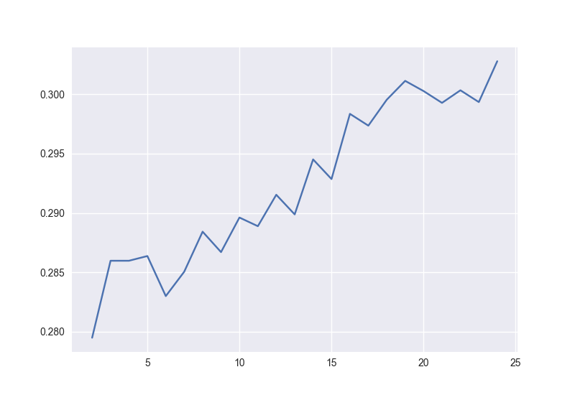
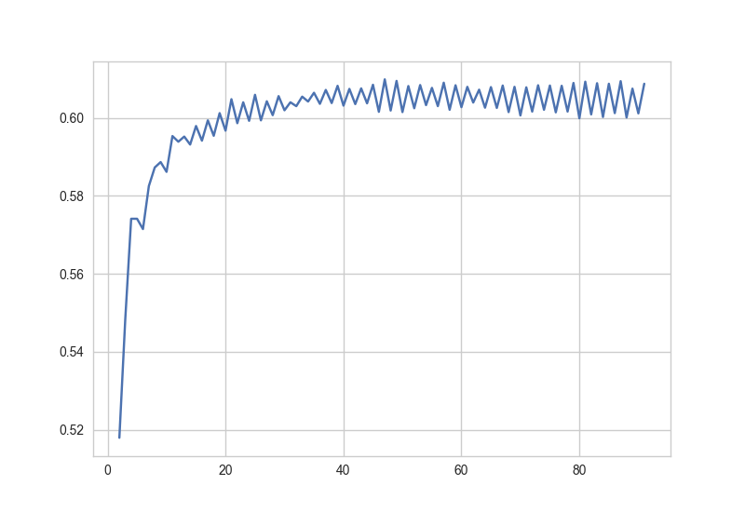
k-NN Approach full training set (GridSearch)
Fitting on 3 columns
['Elevation','Slope','Aspect']
-k = list(range(2, 100)) params={'n_neighbors':k,'weights':['uniform','distance'],'metric':['euclidean','minkowski']}

Slide 18
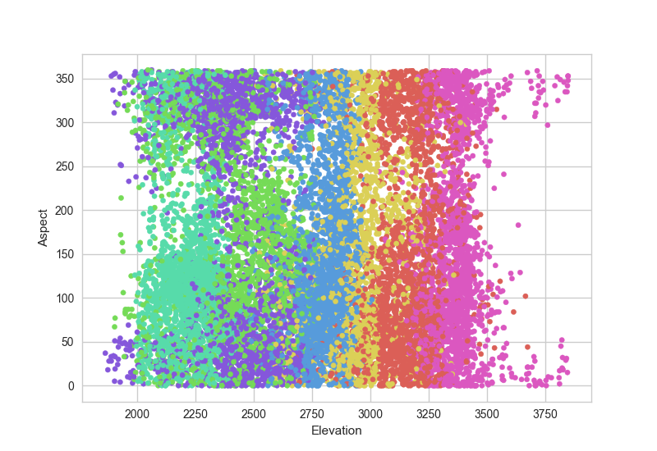
Decision Tree full training set
max_depth = 10
Top Features:
Features Importance Score
Elevation 0.533812
Horizontal_Distance_To_Hydrology 0.064007
Horizontal_Distance_To_Fire_Points 0.064001
Horizontal_Distance_To_Roadways 0.055384
Hillshade_9am 0.052884
Predicted

Slide 19
Decision Tree full training set
max_depth = 10
Actual

Slide 20
Classifiers precision recall f1-score support
1 0.79 0.78 0.78 2160
2 0.78 0.65 0.71 2160
3 0.79 0.78 0.78 2160
4 0.93 0.96 0.95 2160
5 0.80 0.93 0.86 2160
6 0.81 0.80 0.80 2160
7 0.94 0.96 0.95 2160
avg / total 0.83 0.84 0.83 15120
Decision Tree full training set
- max_depth = 10
Predicted
Actual

Slide 21
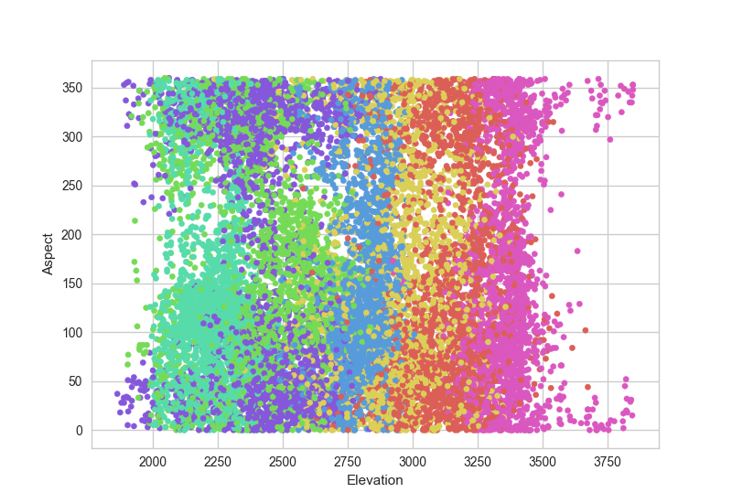
Decision Tree full training set
max_depth = 20
Top Features:
Features Importance Score
Elevation 0.412976
Horizontal_Distance_To_Fire_Points 0.080582
Horizontal_Distance_To_Roadways 0.077953
Horizontal_Distance_To_Hydrology 0.052884
Predicted

Slide 22
Decision Tree full training set
- max_depth = 20
Actual

Slide 23
Classifiers precision recall f1-score support
1 0.99 0.99 0.99 2160
2 0.99 0.96 0.98 2160
3 1.00 0.99 1.00 2160
4 1.00 1.00 1.00 2160
5 0.96 1.00 0.98 2160
6 0.99 1.00 1.00 2160
7 1.00 1.00 1.00 2160
avg / total 0.99 0.99 0.99 15120
Decision Tree full training set
- max_depth = 20
Predicted
Actual

Slide 24
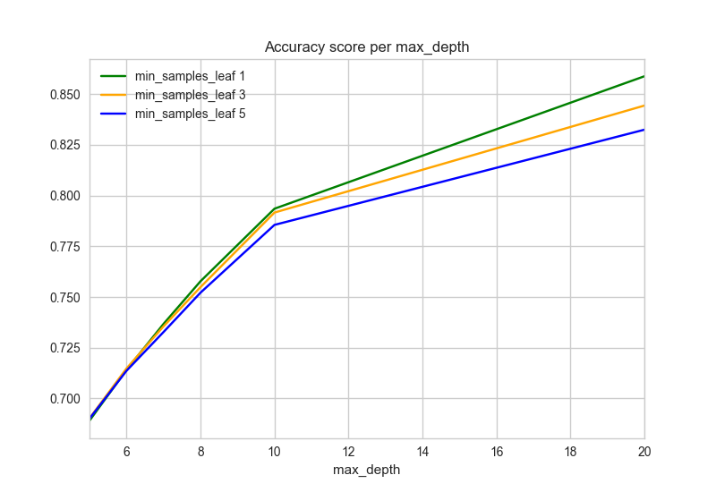
Random Forest full training (GridSearch)
All columns
Best Estimator parameters:
criterion='gini', max_depth=20, max_features='auto',
max_leaf_nodes=None, min_impurity_split=1e-07,
min_samples_leaf=1, min_samples_split=2,n_estimators=200
Classifiers precision recall f1-score support
1 1.00 1.00 1.00 2160
2 1.00 0.99 1.00 2160
3 1.00 1.00 1.00 2160
4 1.00 1.00 1.00 2160
5 0.99 1.00 0.99 2160
6 1.00 1.00 1.00 2160
7 1.00 1.00 1.00 2160
Avg/Tot 1.00 1.00 1.00 15120
Features Importance Score
Elevation 0.412976
Horizontal_Distance_To_Fire_Points 0.080582
Horizontal_Distance_To_Roadways 0.077953
Horizontal_Distance_To_Hydrology 0.063622
Hillshade_9am 0.057822
parameters = {'n_estimators':[10,50,100,200],'class_weight':['balanced',None]
,'max_depth':[5,6,7,8,10,20],'min_samples_leaf':[1,3,5]}

Slide 25
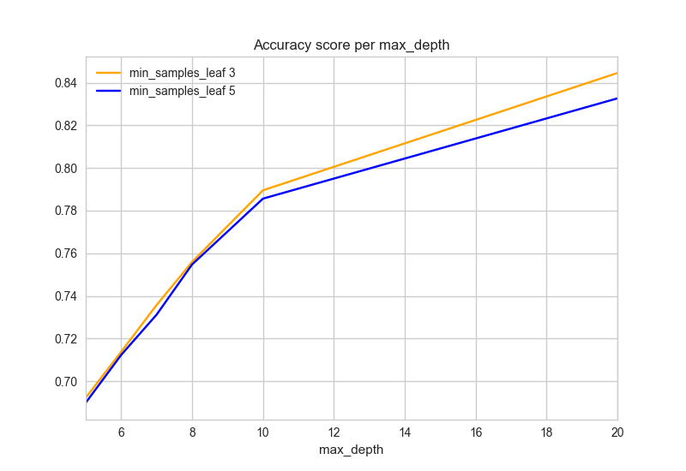
Random Forest full training (GridSearch)
All columns
Best Estimator parameters:
criterion='gini', max_depth=20, max_features='auto',
max_leaf_nodes=None, min_impurity_split=1e-07,
min_samples_leaf=3, min_samples_split=2,n_estimators=200
Classifiers precision recall f1-score support
1 0.95 0.92 0.93 2160
2 0.95 0.88 0.92 2160
3 0.96 0.95 0.95 2160
4 0.96 0.99 0.98 2160
5 0.94 0.98 0.96 2160
6 0.95 0.97 0.96 2160
7 0.97 0.99 0.98 2160
Avg / total 0.96 0.96 0.96 15120
Features Importance Score
Elevation 0.412976
Horizontal_Distance_To_Fire_Points 0.080582
Horizontal_Distance_To_Roadways 0.077953
Horizontal_Distance_To_Hydrology 0.063622
Hillshade_9am 0.057822
parameters = {'n_estimators':[10,50,100,200],'class_weight':['balanced',None]
,'max_depth':[5,6,7,8,10,20],'min_samples_leaf':[3,5]}

Slide 26
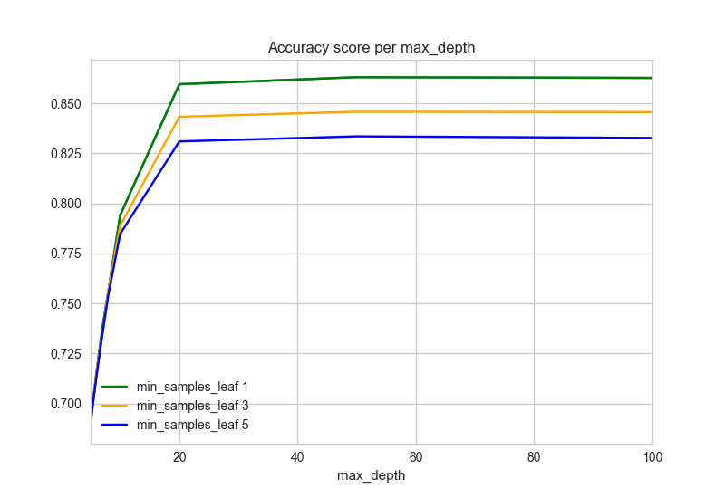
Random Forest full training (GridSearch)
All columns
Best Estimator parameters:
criterion='gini', max_depth=20, max_features='auto',
max_leaf_nodes=None, min_impurity_split=1e-07,
min_samples_leaf=1, min_samples_split=2,n_estimators=200
Classifiers precision recall f1-score support
1 1.00 1.00 1.00 2160
2 1.00 0.99 1.00 2160
3 1.00 1.00 1.00 2160
4 1.00 1.00 1.00 2160
5 0.99 1.00 0.99 2160
6 1.00 1.00 1.00 2160
7 1.00 1.00 1.00 2160
Avg/Tot 1.00 1.00 1.00 15120
Features Importance Score
1 Elevation 0.221542
6 Horizontal_Distance_To_Roadways 0.083257
0 Id 0.082381
10 Horizontal_Distance_To_Fire_Points 0.065605
4 Horizontal_Distance_To_Hydrology 0.055933
5 Vertical_Distance_To_Hydrology 0.048475
parameters = {'n_estimators':[10,50,100,200],'class_weight':['balanced',None]
,'max_depth':[5,6,7,8,10,20,50,100],'min_samples_leaf':[1,3,5]}

Slide 27
Test vs. Kaggle
Models | Train Score | Kaggle
k-NN (Distance) | 1 | 0.44265
k-NN (Uniform) | 0.89 | 0.46762
GridSearch(k-NN all columns) | 0.31 | 0.06621
GridSearch(k-NN 3 columns) | 0.617 | 0.47927
Decision Tree(depth=10) | 0.83 | 0.58539
Decision Tree(depth=20) | 0.99 | 0.58008
NEXT STEPS:
Upload the Random Tree Forest to Kaggle
Exclude columns with high correlations( see correlation matrix)
Try to further optimize it and work on it

